Slide 1
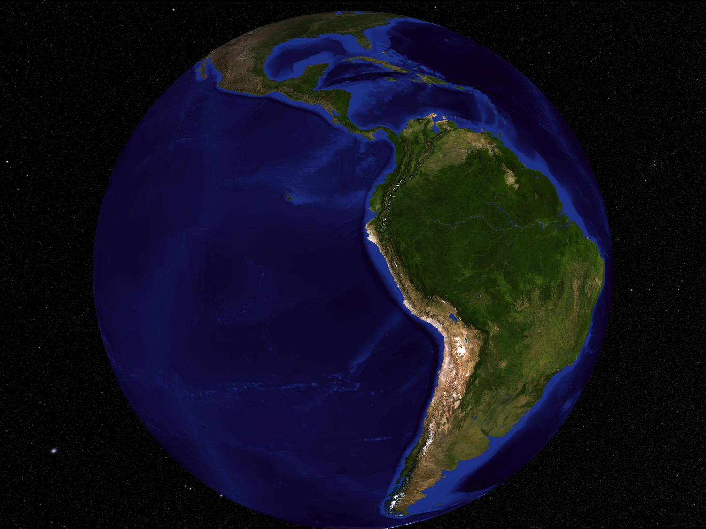
Long-term carbon consequences of Amazon forest degradation
Douglas Morton
11.14.14

Slide 2
Forest degradation research team
NASA GSFC
Other Institutions
Veronika Leitold
Danielle Rappaport
Hyeungu Choi
Marcos Adami (INPE)
Joice Ferreira (EMBRAPA)
Adriano Venturieri (EMBRAPA)
Silvio Brienza (EMBRAPA)
Aline M.M. de Lima (UFPA)
Toby Gardner (U. of Cambridge)
Jos Barlow (U. of Lancaster)
Laurindo Campos (INPA)
Emilio Moran (MSU)
Dengsheng Lu (MSU)
Ted Feldpausch (Exeter)
EMBRAPA CNPM
Mateus Batistella
Michael Keller
Edson Bolfe
Daniel Victoria
Luciana Spinelli
Celina Takemura
Luiz Eduardo Vicente
Débora Drucker
Maiza dos Santos
Ekena Pinagé
Allan Yu Iwama de Mello

Slide 3
Morton et al., 2014
Drivers & Dynamics
Lidar-Biomass Relationships
Full Carbon Accounting

Slide 4
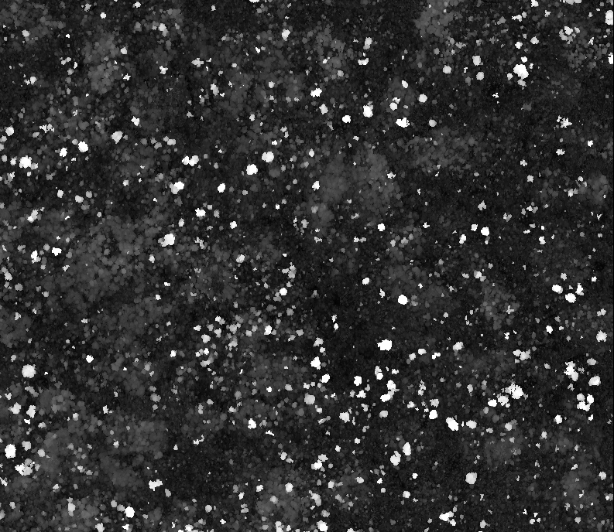
ALS Results: Understory Fires
200 m
FN1: Burned 2004
FNA: Burned 5x
Control

Slide 5
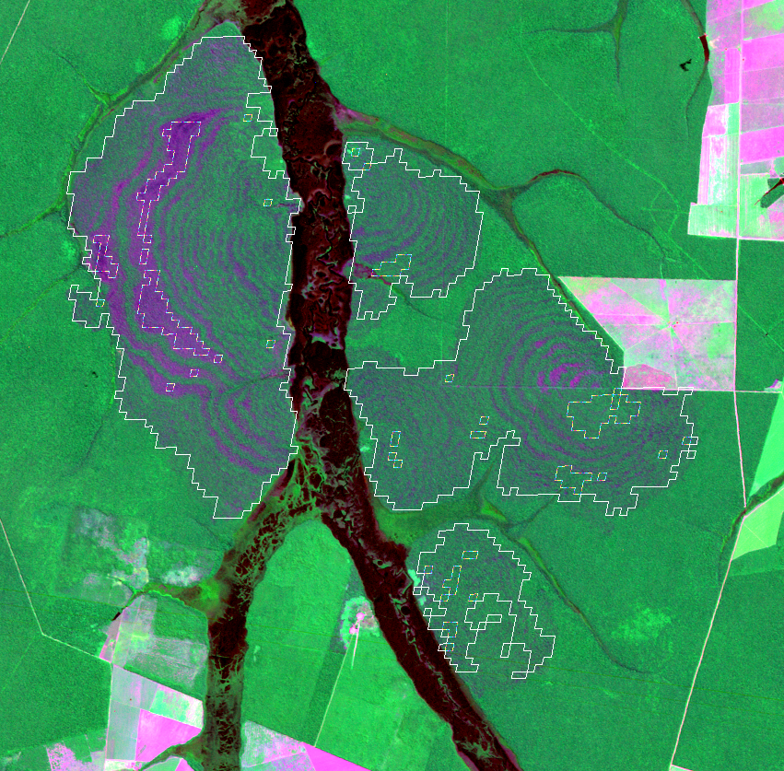
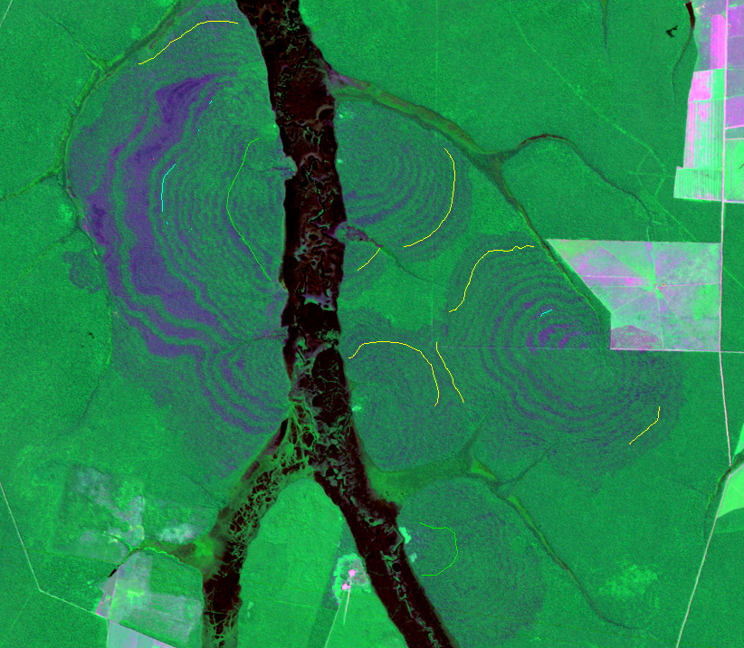
5 km
Morton et al., in prep

Slide 6
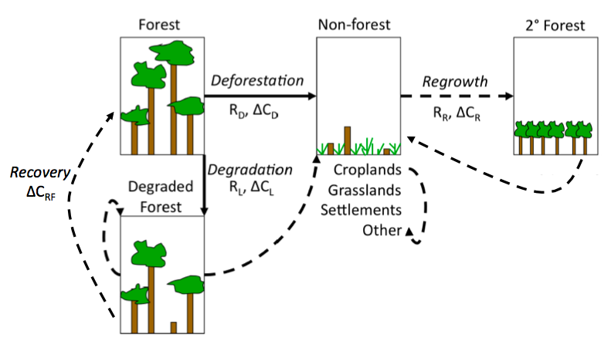
Morton et al., 2012

